Slide 1

Introduction to Enzyme Catalysis
The Enzyme-Substrate Complex
Enzymes are biological catalysts, speeding up reactions without being consumed. The magic happens at the active site, where a substrate (S) binds to the enzyme (E) to form an enzyme-substrate (ES) complex. This complex then transforms, releasing the product (P) and regenerating the free enzyme, ready for another reaction cycle.
Enzyme kinetics studies how quickly enzymes convert substrates (reactants) into products and what factors affect this rate

Slide 2
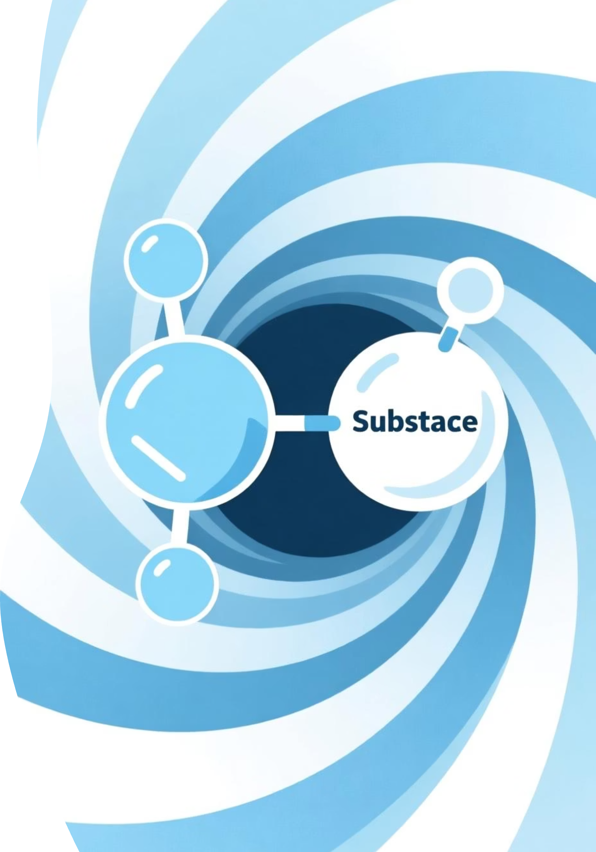
Enzyme Kinetics: Unraveling Reaction Rates
Welcome to our exploration of enzyme kinetics, a fundamental concept in biology and biochemistry. Today, we'll uncover how enzymes drive life's processes by accelerating biochemical reactions.

Slide 3

Pioneers of Enzyme Kinetics
Michaelis & Menten: A Timeless Model
In 1913, Leonor Michaelis and Maud Menten proposed a groundbreaking theory to explain the kinetics of enzyme-catalyzed reactions. Building on earlier work by Victor Henri, they established that the formation of a specific enzyme-substrate (ES) complex is a crucial intermediate step during catalysis.
Their model, though simplified, accurately describes the kinetic properties of many enzymes and remains a cornerstone of biochemistry.

Slide 4
Understanding Km and Vmax
Key Kinetic Parameters
Km (Michaelis Constant):
The substrate concentration at which the reaction velocity is half of Vmax.
It reflects the affinity of the enzyme for its substrate: a lower Km indicates higher affinity.
Vmax (Maximum Velocity):
The maximum rate achieved when the enzyme is saturated with substrate.
V (Rate of Reaction)
How fast the product is formed.

Slide 5

The Michaelis-Menten Equation
Quantifying Reaction Velocity
The Michaelis-Menten equation provides a mathematical framework for understanding how reaction velocity (V0) depends on substrate concentration ([S]):
v₀: Initial reaction velocity
Vmax: Maximum reaction velocity
Km: Michaelis constant
[S]: Substrate concentration
This elegant equation beautifully captures the relationship between these key parameters in enzyme kinetics.

Slide 6
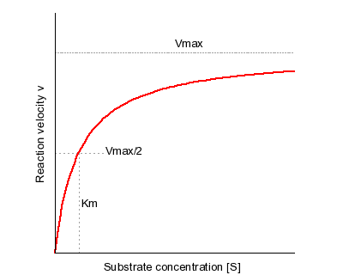
Visualizing Enzyme Kinetics
The Hyperbolic Curve
when [S]<< Km - the reaction rate is directly proportional to substrate concentration
when [S]>>Km - the reaction rate is maximum and independent of substrate concentration
[S]=Km - the reaction rate is half of Vmax
Difference between Vmax and Km
Substrate Concentration ([S])
Initial Velocity (v0)
This graph shows how the reaction rate increases with substrate until it reaches saturation at Vmax.

Slide 7

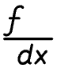
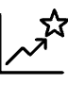
VMAX: The Turnover Number (kCAT)
Vmax represents the maximum reaction rate when the enzyme is fully saturated with substrate. This parameter is directly related to the enzyme's catalytic efficiency, often expressed as the turnover number, kcat.
Definition
Calculation
What it tells us
kcat is the number of substrate molecules converted to product per enzyme active site per unit time, under saturating substrate conditions.
kcat = Vmax / [E]T, where [E]T is the total concentration of enzyme active sites.
A high kcat indicates a highly efficient enzyme, capable of processing many substrate molecules quickly.
For example, carbonic anhydrase, one of the fastest enzymes, has a kcat of 600,000 s-1, meaning it can convert 600,000 molecules of CO2 into bicarbonate per second!

Slide 8
Assumptions for Michaelis-Menten
Simplifying the Complexity
Negligible Reverse Reaction
Single ES Complex
Assumes the product (P) does not revert back to substrate (S).
Assumes only one enzyme-substrate complex (ES) forms and breaks down into E + P.
Substrate in Excess
Steady State Approximation
Assumes substrate concentration ([S]) is much greater than enzyme concentration ([E]).
The concentration of the ES complex remains constant over time.
Single substrate Reaction
Assumes no binding of a second substrate molecule

Slide 9


Section 2
Enzyme Inhibition: Regulating Enzyme Activity
Enzyme inhibitors are molecules that decrease the rate of an enzyme-catalyzed reaction.
The process is known as enzyme inhibition.
They play crucial roles in regulating metabolic pathways, drug design, and understanding enzyme mechanisms.
Irreversible Inhibition
Inhibitors bind tightly and permanently to the enzyme, often forming a covalent bond or a very stable non-covalent interaction. This leads to a sustained loss of enzyme activity.
Example: Penicillin inhibits bacterial transpeptidase, preventing bacterial cell wall synthesis.
Aspirin inhibits cyclooxygenase, reducing inflammation.

Slide 10



Reversible Inhibition: Three Key Types
Unlike irreversible inhibitors, reversible inhibitors rapidly dissociate from the enzyme-inhibitor complex. They can be classified into three main types based on their binding site and effects on Km and Vmax.
Competitive
Non-competitive
Uncompetitive
Inhibitor competes with substrate for the active site.
Inhibitor binds to a site distinct from the active site, affecting catalysis.
Inhibitor binds only to the enzyme-substrate complex.
Understanding these distinctions is crucial for designing drugs and interpreting enzyme kinetics experiments.

Slide 11
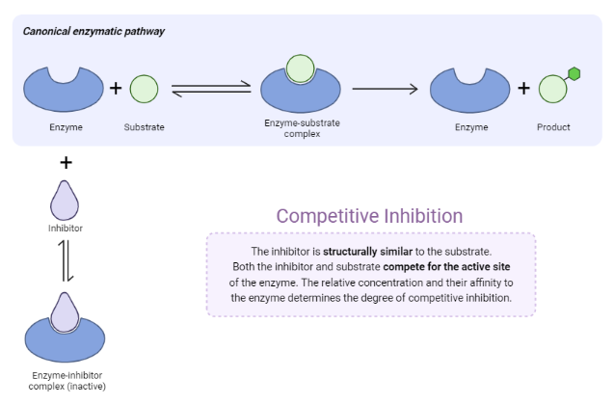
Competitive Inhibition
In competitive inhibition, the inhibitor (I) closely resembles the substrate (S) and competes for binding to the enzyme's active site.
Mechanism
The enzyme can bind either the substrate to form ES or the inhibitor to form EI, but not both simultaneously at the active site.
Kinetic Effects
Vmax: Unchanged. At very high substrate concentrations, the inhibitor can be out-competed.
Km: Appears Increased. More substrate is needed to reach half Vmax because of the inhibitor's presence.
This inhibition can be overcome by increasing substrate concentration.

Slide 12
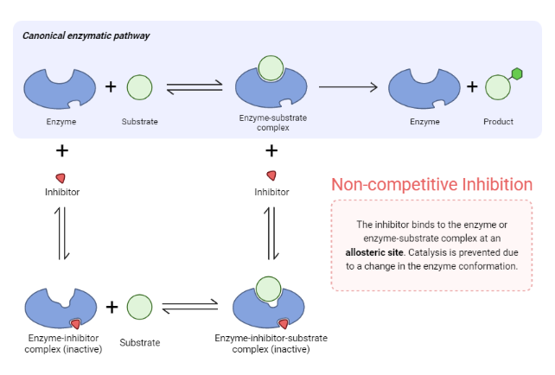
Non-Competitive Inhibition
In non-competitive inhibition, the inhibitor binds to a site on the enzyme distinct from the active site, meaning it does not compete directly with the substrate.
Mechanism
The inhibitor has no structural similarity to the substrate and can bind to the free enzyme (E) or the enzyme-substrate complex (ES). Binding of the inhibitor causes a conformational change that reduces the enzyme's catalytic efficiency.
Kinetic Effects
Vmax: Decreased. The inhibitor effectively reduces the concentration of functional enzyme.
Km: Unchanged. The inhibitor does not affect the enzyme's affinity for the substrate.

Slide 13
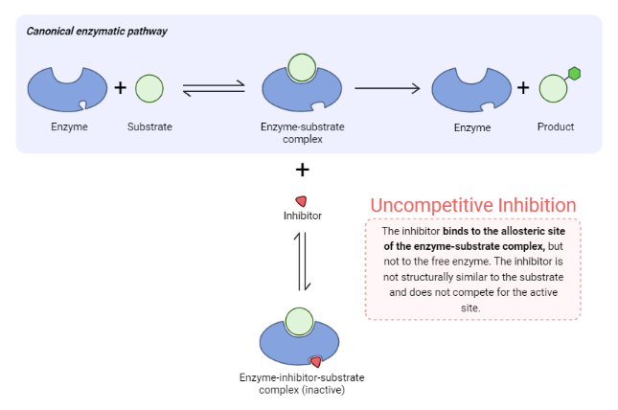
Uncompetitive Inhibition
Uncompetitive inhibition is unique because the inhibitor binds exclusively to the enzyme-substrate (ES) complex. It cannot bind to the free enzyme.
Mechanism
The binding of the substrate induces a conformational change in the enzyme, creating a binding site for the uncompetitive inhibitor. The resulting ESI complex is catalytically inactive.
Kinetic Effects
Vmax: Decreased. The formation of the inactive ESI complex reduces the overall catalytic rate.
KM: Appears Decreased. The inhibitor 'traps' the enzyme in the ES complex, effectively increasing the enzyme's apparent affinity for the substrate.

Slide 14
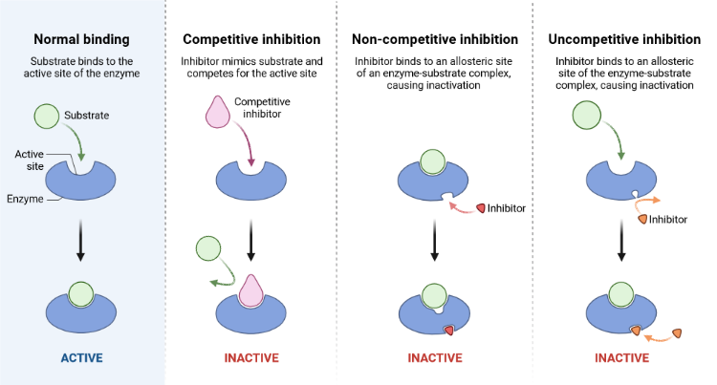

Slide 15
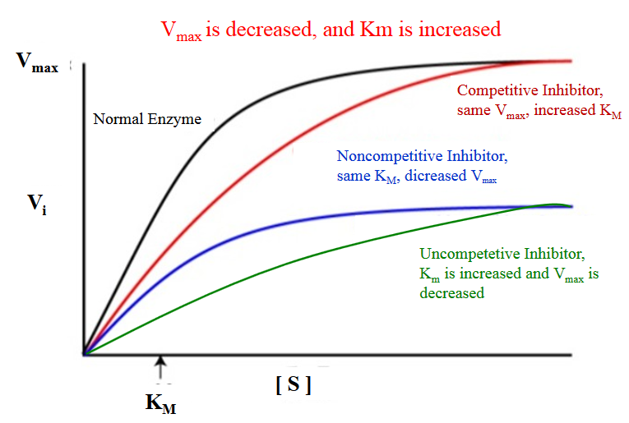
 | Competitive inhibition | Non-competitive inhibition | Uncompetitive inhibition
Vmax | No change | Decreases | Decreases
Km | Increases | No change | Decreases

Slide 16
An enzyme hydrolyzed urea at [S]= 0.003mmol/L with KM value of 0.06 mmol/L. the initial velocity was 1.5 x 10-3 mmol/L and maximum velocity was 4.5 x 10-3 mmol/L.mol-1. Calculate the Km.
Urease enzyme hydrolyzed urea at [S]= 0.03 mmol/L with a Km value of around 0.06 mmol/L. The initial velocity observed was 1.5x10-3 mmol/L.min-1. Calculate the-maximum velocity of-the enzymatic-reaction
An enzyme hydrolyzed a substrate concentration of 0.03 mmol/L, the initial velocity was 1.5x10 3 mmol/L.min-1 and the maximum velocity was 4.5 x 10-3 mmol/L.min-1. Calculate the substrate concentration that gives a velocity of 3 x 10-3 mmol/L.min-1.

Slide 17
Unit 1: Biomolecules and Enzymes
Topic IA1: Enzymatic Processes in Industrial Production & its application
Question:
Select any one enzyme that is used in an industrial process and explain how it contributes to the production of a specific industrial product.
Your presentation should clearly describe the entire process, including:
The role of the enzyme
Process conditions
Details of the product (you can add picture of the product)_please give reference of the picture used.
Its industrial applications
Instructions:
1. Each student must select one enzyme and one industrial product.
2. The selected enzyme should play a critical role in the production of chosen products.
3. Prepare 2–3 slides based on your content.
Add one reference slide at the end where you list all references. For example, if you use a product image from Google, kindly copy the link and mention it in the reference slide.
In your content slides, select any one enzyme of your choice (e.g., amylase) and one product that a company manufactures using that enzyme.
Then, include information on how the company uses the enzyme in the production of the final product.
Label your file as division followed by last digits of your roll number, hyphen and your name (A01-XYZ).

